Slide 1
San Francisco Fire Suppression Personnel Predictor
Anjali Bandaru : 013854126
Arkil Thakkar : 013825292
Mrunali Sanjay Khandat : 013723177

Slide 2
Introduction to Problem and Objective
The project uses past records of fire incidents in San Francisco to predict number of Suppression personnel to be sent during Fire incidents.
This kind of Analysis provides more insights to Fire departments to make certain decisions during fire incident .
Test different Regression methods for supervised learning: Ridge, Lasso, Gradient Boosting and Random Forest Regressor
Compare different model's performance on various evaluation metric

Slide 3
Dataset
Attribute | Type | Attribute Description
Property Use | Text | Description of property
Primary Situation | Text | Incident type that best describes the situation at the scene.
Detector Alerted Occupants | Text | Did detector alert present ?
Station Area | Text | Fire station first response
Battalion | Time | Emergency Response District
Zip Code | Text | Zip Code of incident
Supervisor District | Text | Supervisor District associated with this address
Address | Text | Apt and Street address where crime happened
Structure Type | Text | Structural involved in structural fire
Exposure Number | Number | Sequence Number for fire involved
Action Taken Primary | Text | Primary Action taken to resolve
Alarm DateTm | Date & Time | First Unit to this call
Dataset from ‘DataSF’ for Fire Incidents
https://data.sfgov.org/Public-Safety/Fire-Incidents/wr8u-xric
490K rows/incidents
Total 67 features
Relevant Features

Slide 4
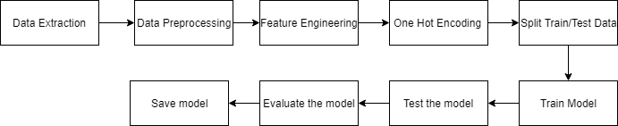
Methodology/Architecture
Two approaches:
Approach 1 – Standard Scalar to normalize
Approach 2 – CSR matrix

Slide 5
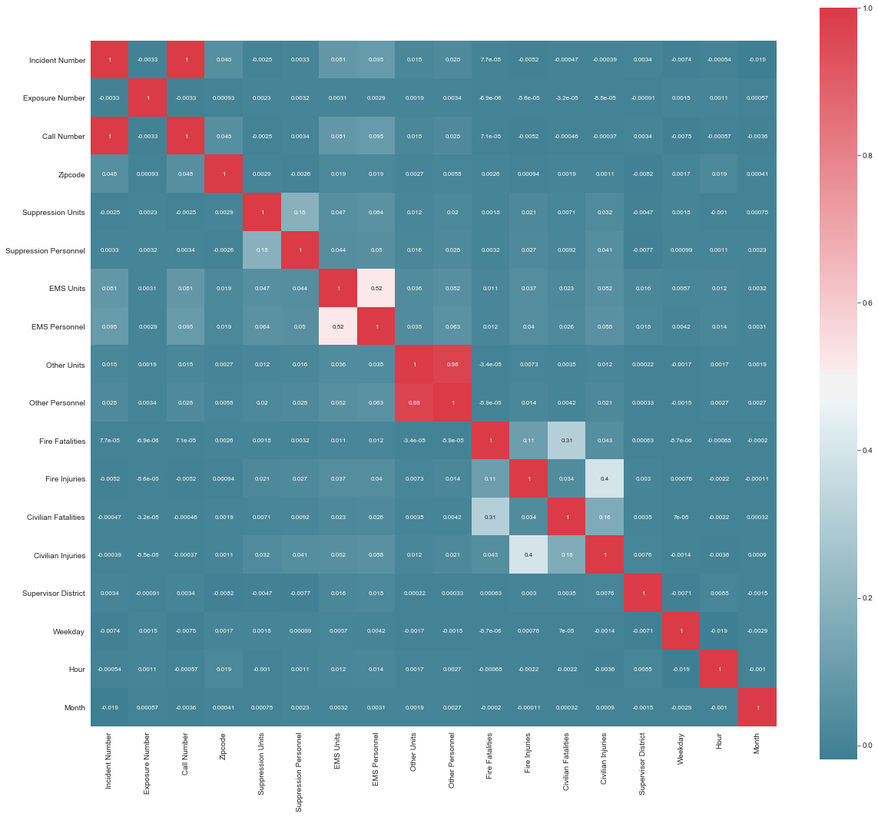
Data Preprocessing
Correlation between features
Imputing Missing Values
Extracting Number out of Strings
Dropping Irrelevant Features
One Hot Encoding of Categorical
Fields
Dropping columns that are missing
Values in more than half of rows

Slide 6
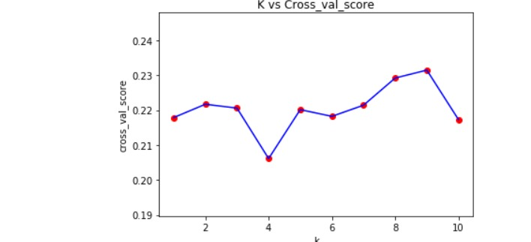
Lasso Regression
Discards variables not strongly associated
Alpha is 0.1.
Used K-fold cross validation for training dataset and training output to get cross validation scores.
K is 10
MSE is 33.98

Slide 7
Gradient Boosting
Ensemble of Weak Prediction Model
MSE obtain : 28.01
Tuning of Different parameters
N_estimators
Learning Rate
Max_depth
Loss function

Slide 8
Random Forest
Flexible
Builds and merges multiple decision trees
Parameter:
N_estimators
Max_depth
MSE obtained : 37.87

Slide 9
Ridge Regression
Multicollinear data
Adds bias to estimates
Reduces standard errors
Parameter- Alpha
MSE Obtained : 27.11
Analysis - Best Algorithm

Slide 10
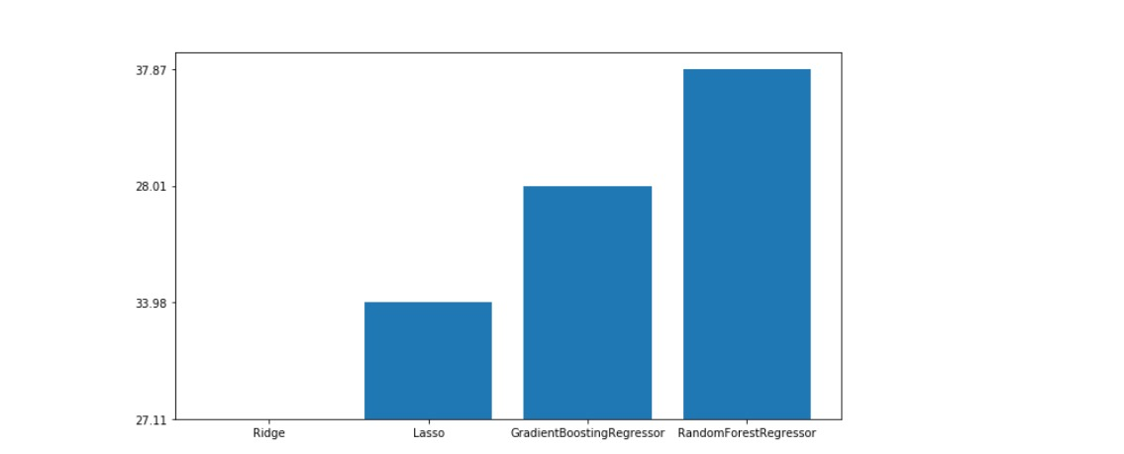
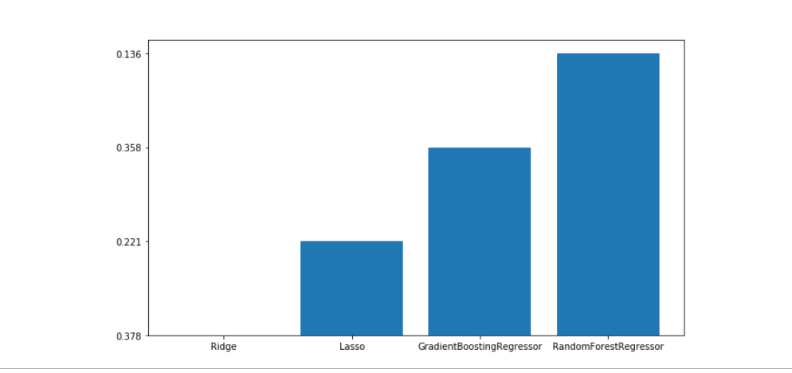
Model Comparison
Mean Square Error
R2 Score

Slide 11
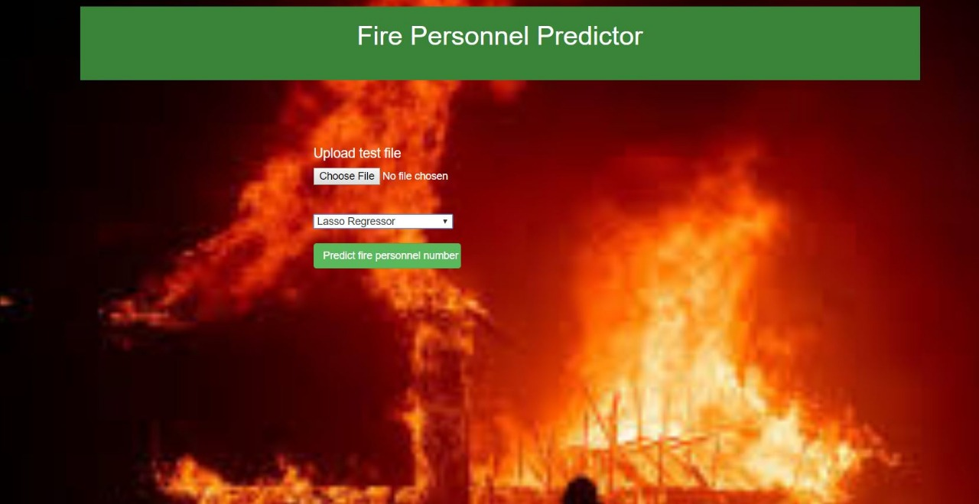
GUI

Slide 12
Difficulties Faced
Not clean dataset, hence preprocessing difficult
CSR matrix improved MSE, but took more execution time

Slide 13
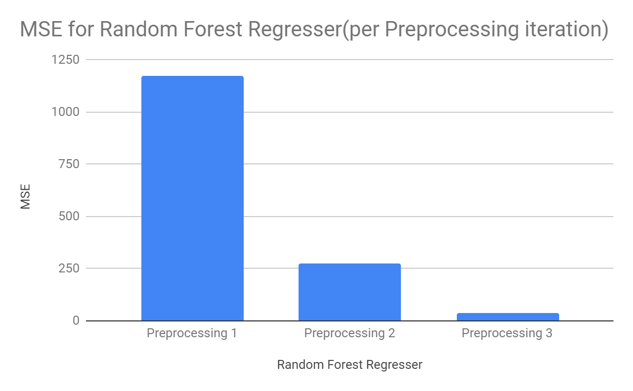

Slide 14
Things that worked Things that didn’t work
CSR Matrix conversion Preprocessing change | Standard Scaler Using SVD

Slide 15
Conclusion
Noise and outliers affect knowledge discovery from data
Data preprocessing - crucial step in data mining
Explore different algorithms with different set of parameters and evaluate the best one

Slide 16
Thank You!

